Slide 1

R3.12 Employment
Written application and job interview

Slide 2
Module assignment
Written test week 40
CV deadline 11/10 @ 11 pm on madoc
Job interviews on weeks 42 & 43- bring a paper copy of your CV

Slide 3
The Basics
CV: Resume or CV
Lettre de motivation: Cover letter
Candidature: Application
Candidat: Applicant
Poste: Position/ role
Stage: Internship (a 3-month internship) or work placement (UK)
Stagiaire: Intern
Effectuer un stage: Carry out or complete an internship
Une formation: A course
Dilpômé: Graduate (être diplômé: to graduate. Ex: I will graduate in September)
Compétence: Skill
Offre d’emploi: Jod ad (advertisement)

Slide 4
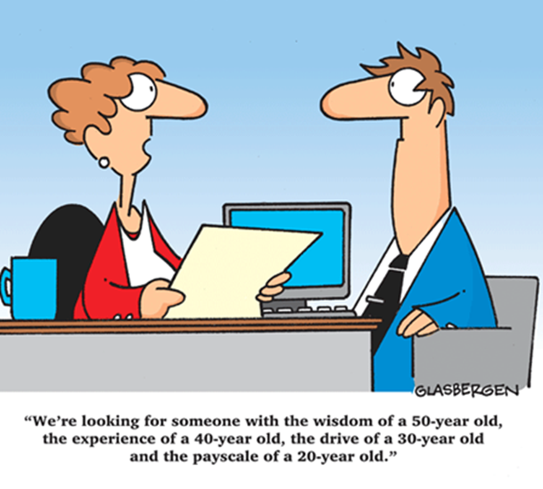
Part 1: writing a CV

Slide 5
Goals of a resume
  explain educational credentials
  specify tech skills and demonstrate level
  showcase internship duties (Strong verb + job duty+ impact, links to portfolio/git)
  showcase academic projects Strong verb + job duty+ impact
  showcase personal projects Strong verb + job duty+ impact
  → demonstrate your ability to learn, self-teach
  → Your ability to work effectively as part of a team

Slide 6
Structure of a CV
  _{Header with contact details}
  profile/ summary of strong points for the post (tech skills, exp and qualities)
  technical skills (don’t forget S4 topics PHP, JS, NodeJS, ReactJS, Code igniter)
  education: degree + coursework highlights (relevant modules)
  _{academic and personal projects}
  _{internship / work experience}
  _{(personal interests)}
  _{references}

Slide 7
Tailor make the CV for the job
List the tech skills and soft skills / qualities for the internship
Everything you list on your CV must demonstrate those skills: education (modules, labs), academic projects, personal projects, internship, extra curricular activities
Only select the relevant aspects for each which will help illustrate those skills and qualities

Slide 8
Using a resume builder
The basic or free versions do not offer AI aided writing of sections or limited help
Enhance (LinkedIn) can format, will run ATS scan and give you a score, and identify weaknesses but will not correct them, only for premium 16-20£/month
Cvdesignr with an account/generates generic template from job ad for free but default phrases and structure for experienced dev/ translation, AI-gen content and ATS score with premium version (10€/month)
Chatgpt effective for content but struggles with the formatting
Your data is shared with third party vendors: use fake details except email address
Start from scratch rather than using an existing CV, can be tailored to a job ad, or a type of position, but tends to generate phrases and format of more experienced profiles.
= use it as a basis for building your CV, but build on it and tailor it

Slide 9
The Skills section
Divide into categories, order and selection depends on job ad:
  Languages and frameworks
  Backend development
  Database
  DevOps and deployment/ versioning tools and IDE
  Testing tools
  Tools and platforms (project management)
  Systems and Network
  Rank in order of importance for the job

Slide 10
Education
University Bachelor of Technology in Computer Science (Bachelor Universitaire de Technologie en informatique)
Nantes Université
Full-time* three-year Degree, divided into six semesters for a total of 2,000 hours of classes.
30h per week, 50% labs
22 to 26-week internship, spread out across the 2nd and 3rd year.
600 hours dedicated to semester projects.
*Alternance: work-study programme

Slide 11
Explaining your education (UK & US)
_{French qualifications} | _{UK} | _{US}
Bachelor Universitaire de Technologie Informatique | equivalent to a UK’s Bachelor’s Degree with Honours in Computing- RQF Level 6 2,000 contact hours over 3 years (900 hours of labs) + 300 hours independent projects | 3‑year applied bachelor (EQF 6). Equivalent to a US Bachelor’s in Computer Science (foreign credential) 2,000 contact hours over 3 years (900 hours of labs) + 300 hours independent projects

Slide 12
Explaining your education (UK & US)
 | UK | US
_{14/20} | _{first/ 1 : 1} | _{GPA 4.0 with honours}
_{13/20} | upper second class honours (2:1): mention bien | _{GPA 3.5}
_{11/20} | lower second class honours: (2:2) mention Bien | _{GPA 3}
_{Baccalauréat Scientifique} | equivalent to 4 or 5 "A levels" including Maths and Physics | equivalent to a "high school leaving certificate" with Maths and Physics
_{Mention bien} _{TB} | _{with merit} with distinction/ with honours/ first class honours | _{Cum laude}

Slide 13
Coursework
explain each topic to an outsider/ potential employer- what have you learnt at school on this topic
  modules
  lectures (CM)
  lessons & tutorials (TD)
  practicals or labs (TP)
  + projects (academic or personal)
  what do you know how to do? (level of proficiency)

Slide 14
Explaining your education
Coursework highlights/ relevant modules:
  Programming, OOP
  Network architecture, System programming
  Web Development
  Mobile application development
  Database
You can detail. For example, for a C++ oriented CV:
  completed C++ course
  introduction to Computer Systems
  problem solving for engineering case studies: Emphasis was on the design of algorithms and their implementation for solving engineering problems using C
  introduction to Visual Basic

Slide 15
Showcasing your projects & experience
In your description, use the STAR method
Situation (assignment, level)
Task (specs, technologies and tools, team, hours)
Action (action verbs, specific and individual)
Result (completion, functional or not, impact)

Slide 16
Example
Situation: Our team struggled with manual bug tracking, causing delays in software releases.
Task: I was tasked with building an automated issue-tracking system to streamline reporting and resolution.
Action: I developed a full-stack web app using React, Node.js, and PostgreSQL, implementing real-time notifications and priority-based filtering.
Result: The system reduced bug resolution time by 40% and improved team productivity.

Slide 17
Showcasing your experience
Built a responsive web app using Django and Node that allowed users to schedule social media posts across Instagram and Twitter
● Utilized the Twitter API and Instagram API
● Built features using scikit-learn in Python that learned what time of day maximized engagement with social media posts which increased the overall engagement rate by 15% for users
● Released it for free for University of Pittsburgh students and it quickly grew to over 500 monthly active users
● Used: Javascript, Python, SQL, HTML/CSS

Slide 18
Work experience
Summer jobs
Part time jobs
Select aspects of the job which will help you demonstrate the soft skills listed in the job ad
Typically: team work, communication skills, organisational skills

Slide 19
Extra curricular activities
Sports activities
Volunteer work
Use action verbs
Be specific
Select aspects of the job which will hep you demonstrate the soft skills listed in the ad

Slide 20
Personal interests
Certifications
Hackathons, workshops or conferences, CTF
MOOC
Self-motivated activities or distinctive personal knowledge trips.
Contributing to open-source projects and developer communities.

Slide 21
Writing a profile
  A summary of what you can bring the company
  Should include your skills, qualities, education and experience for the post with your strong points
  Try to reuse keywords from the job ad and ideally the name of the company

Slide 22
Examples of profiles
Seeking an entry-level Web Developer position with Fair Foods Groceries where I can apply my attention to detail and the knowledge I learned while earning my BSc. in Web Design to enhance the web visitor’s experience with the company so they can shop online and experience a seamless online visit.
Enthusiastic and hard working Web Developer with three years of experience seeking a position with Site Smart Solutions where I can offer my debugging expertise in Java to clients and customers

Slide 23
Qualities
  Outgoing
  versatile
  Hardworking
  Detail oriented with strong analytical skills
  Proactive /enterprising
  resourceful
  Team player
  Focused, persistent problem solver
  Enjoys working as a team as well as independently
  adaptable

Slide 24
Design, visuals
Include some dynamic elements:
infographics (with caution, not ATS compatible)
Clickable portfolio- provided the portfolio or github profile is actually clean, polished and relevant (see separate document on madoc)
LinkedIn profile: update it regularly, list your most important skills first, in the title

Slide 25
Research the company
  On their website: products, services, size, history (about us), who is the CEO?
  Check their LinkedIn page
  Check their social media
  Google the company for news, major projects
  Mission statements, values

Slide 26
Research the company
  Google trends- what’s the competition
  google alerts (set to 1 weekly) *job title* *Capgemini/careers*
  Check LinkedIn- have you found out people who work there -related to your position/ department (maybe info on the interviewers)
  For large companies, search their white papers
  Employee feedback (glassdoor), reuse if positive
  News, press releases

